Slide 1


BCSE307L – Compiler Design
Module 7 – Parallelism

Slide 2
Parallelization
Parallelizing (or multithreading) an application compiles the program to run on a multiprocessor system or in a multithreaded environment.
Parallelization enables a single task, such as a DO loop, to run over multiple processors (or threads) with a potentially significant execution speedup.
Before an application program can be run efficiently on a multiprocessor system (like the Ultratrademark 60, Sun Enterprise trademark Server 6500, or Sun Enterprise Server 10000), it needs to be multithreaded.
(i.e.) tasks that can be performed in parallel need to be identified and reprogrammed to distribute their computations across multiple processors or threads.
In some compilers (eg. Fortan compiler), parallelization distributes the computational work of a loop over several processors without requiring modifications to the source program.

Slide 3
Cont…
Not all loops in a program can be profitably parallelized.
Loops containing only a small amount of computational work (compared to the overhead spent starting and synchronizing parallel tasks) may actually run more slowly when parallelized.
Also, some loops cannot be safely parallelized at all; they would compute different results when run in parallel due to dependencies between statements or iterations.
Implicit loops (E.g.: IF loops and arrays within loops) as well as explicit DO loops are candidates for automatic parallelization by the compilers.
Compilers can detect loops that might be safely and profitably parallelized automatically.
However, in most cases, the analysis is necessarily conservative, due to the concern for possible hidden side effects.
By inserting source code directives before loops, you can explicitly influence the analysis, controlling how a specific loop is (or is not) to be parallelized.

Slide 4
Automatic Parallelization
Automatic conversion of sequential programs to parallel programs by a compiler
Target may be a vector processor (vectorization), a multi-core processor (concurrentization), or a cluster of loosely coupled distributed memory processors (parallelization)
Parallelism extraction process is normally a source-to-source transformation
Requires dependence analysis to determine the dependence between statements
Implementation of available parallelism is also a challenge
For example, can all the iterations of a 2-nested loop be run in parallel?

Slide 5
Example 1
for I = 1 to 100 do
{
X (I) = X (I) + Y (I)
}
can be converted to
X(1:100) = X (1:100) + Y (1:100)
The above code can be run on a vector processor in O(1) time. The vectors X and Y are fetched first and then written into the vector X
The vectorization is possible because there is no dependence between these iterations
For example, this writes X1 equal to X1 plus Y1, the second iterations writes X2 equal to X2 plus Y2. Each iteration writes and reads different X and Y items, so there is no dependence from one iteration to another.

Slide 6
Example 2
for I = 1 to 100 do
{
X (I) = X(I) + Y(I)
}
can be converted to
forall I = 1 to 100 do { X (I) = X (I) + Y (I) }
The above code can be run on a multi-core processor with all the 100 iterations running as separate threads. Each thread "owns" a different I value
What happens is there will be 100 iterations running as separate threads assuming that there are 100 cores possible.
Each thread actually owns a different I value, so for I equal to 1 there is a thread, for I equal to 2 there is another thread and so on. Each thread is responsible for executing one of the iterations, so X I equal to X I plus Y I.
Since, the I values are all different, again each thread writes and reads from a different X location and Y location.

Slide 7
Example 3
for I = 1 to 100 do { X (I+1) = X(I) + Y (I) }
cannot be converted to
X (2:101) = X(1:100) + Y (1:100)
because of dependence as shown below
X (2) = X (1) + Y (1)
X (3) = X(2) + Y (2)
X (4) = X(3) + Y (3)
What is written in the first iteration is read in the second iteration. Similarly, what is written into in the second iteration that is X of 3 is read in the third iteration X of 3 again.
There is a dependence from one iteration to the next iteration, what is written in this iteration is read in the next iteration
Simple example of code that cannot be parallelized.

Slide 8
Transformations before Dependence Analysis
Array subscripts should be linear functions of loop variables
Loop lower bound should be one and the loop increment should be one
A few loop transformations are carried out to ensure the above
Loop normalization
Induction variable substitution
Expression folding and forward substitution

Slide 9
1. Loop Normalization
Loop lower bound→ 1, and loop increment → 1
Original Loop | Normalized Loop
for I = 1 to 100 do { KI = I for J = 1 to 300 by 3 do { KI = KI + 2 U(J) = U(J)*W(KI) V(J+4)= V(J)*W(KI) } } | for I = 1 to 100 do { KI = I for J = 1 to 100 do { KI = KI + 2 U(3*J-2) = U(3*J-2)*W(KI) V(3*J+1) = V(3*J-2)*W(KI) } J = 301 }
loop indices are changed and the subscripts have been changed in order to satisfy this loop increment equal to 1

Slide 10
2. Induction Variable Substitution
for I = 1 to 100 do {
KI = I
for J = 1 to 100 do {
U (3*J-2) = U (3*J-2) * W (KI+2*J)
V (3*J+1) = V (3*J-2) * W (KI+2*J)
}
KI = KI + 200
J = 301
}
Now KI is a constant in the J-loop. This is the inverse of operator strength reduction

Slide 11
3. Expression Folding and Forward Substitution
for I = 1 to 100 do {
for J = 1 to 100 do {
S1: U(3*J-2) = U(3*J-2) * W(I+2*J)
S2: V(3*J+1) = V(3*J-2) * W(I+2*J)
}
ΚΙ = I+200 // may be deleted if KI is not live
J = 301 // may be deleted if J is not live
}
Replaced KI with I, since KI is a constant
Now, all subscripts are linear functions of loop variable needed for the dependence analysis
Suppose KI and J are actually not used, later on they do not live after this point, then in that case we can delete these two statements, they will not be needed, otherwise we need to retain them

Slide 12
Vector Code Generation
I = 1, J = 1, S1: U(1) = U(1) + ……
S2: V(4) = V(1) + ……
J = 2, S1: U(4) = U(4) + ……
S2: V(7) = V(4) + ……
The dependence S1 Ꟙ_{(=,=)} S1 is harmless for vectorization of S1
But, the dependence S2 Ꟙ_{(=,<)} S2 prevents vectorization of S2
for I = 1 to 100 do {
U (1:298:3) = U(1:298:3) * W (I−2:I+200:2) //S1 is Vectorized
for J = 1 to 100 do {
V(3*J+1) = V (3*J-2) + W (I+2*J)
}
}

Slide 13
Data Dependence relations
There are three types of dependence
In flow dependence the two statements S1 and S2 share a variable X, S1 writes into it and then S2 in the same execution order reads form it.
Anti-dependence is the other way, S1 reads from X and then S2 writes into X, so you first read and then write.
Output dependence is S1 writes into X and then S2 also writes into X, but then you cannot really change the order of S1 and S2.
e.g. if output dependence is violated and the output device is a printer then the printed output may appear in jumbled form.

Slide 14
Data Dependence Direction Vector
Used to analyze and classify the dependencies between the iterations in the loop
Forward or "<" direction means dependence from iteration i to i+k (i.e., computed in iteration i and used in iteration i+k)
Backward or ">" direction means dependence from iteration i to i-k (i.e., computed in iteration i and used in iteration i-k). This is not possible in single loops and possible in doubly or higher levels of nesting
Equal or "=" direction means that dependence is in the same iteration (i.e., computed in iteration i and used in iteration i)

Slide 15
Data Dependence Graph (DDG) and Vectorization
Individual nodes are statements of the program and edges depict data dependence among the statements
Vectorization
Operations that are performed on multiple components of a vector at the same time (in one statement)
Eg. A=rand(1,4); B=rand(1,4); c = a+b;
If the DDG is acyclic, then vectorization of the program is straightforward
Vector code generation can be done using a topological sort order on the DDG
Otherwise, find all the strongly connected components of the DDG, and reduce the DDG to an acyclic graph by treating each SCC as a single node

Slide 16
Data Dependence Graph and Vectorization
Any dependence with a forward (<) direction in an outer loop will be satisfied by the serial execution of the outer loop
If an outer loop L is run in sequential mode, then all the dependences with a forward (<) direction at the outer level (of L) will be automatically satisfied (even those of the loops inner to L)
For those dependences with (=) direction at the outer level; the dependences of the inner loops will have to be satisfied by appropriate statement ordering and loop execution order

Slide 17
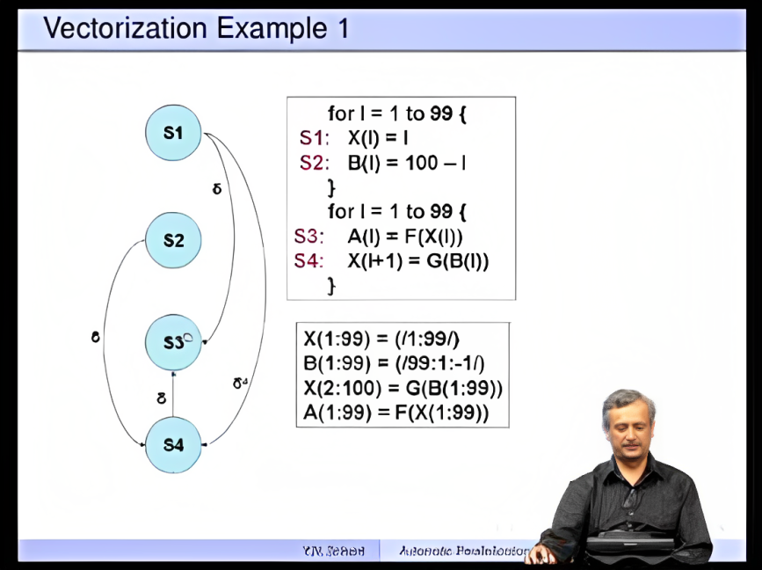
Vectorization Example 1
S1 to S3 flow dependence
S1 to S4 output dependence
S2 to S4 flow dependence
S4 to S3 flow dependence

Slide 18
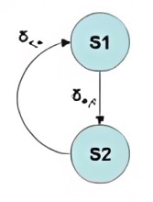
Example 2
for I = 1 to 100 do {
for J = 1 to 100 do {
for K = 1 to 100 do {
S1: X(I, J+1, K) = A(I, J, K) + 10
}
for L = 1 to 50 do {
S2: A(I+1, J, L) = X(I, J, L) +5
}
}
}
for 1= 1 to 100 do {
X(I, 2:101, 1:100) = A(I, 1:100, 1:100) + 10
A(I+1, 1:100, 1:50) = X(I, 1:100, 1:50) + 5
}

Slide 19
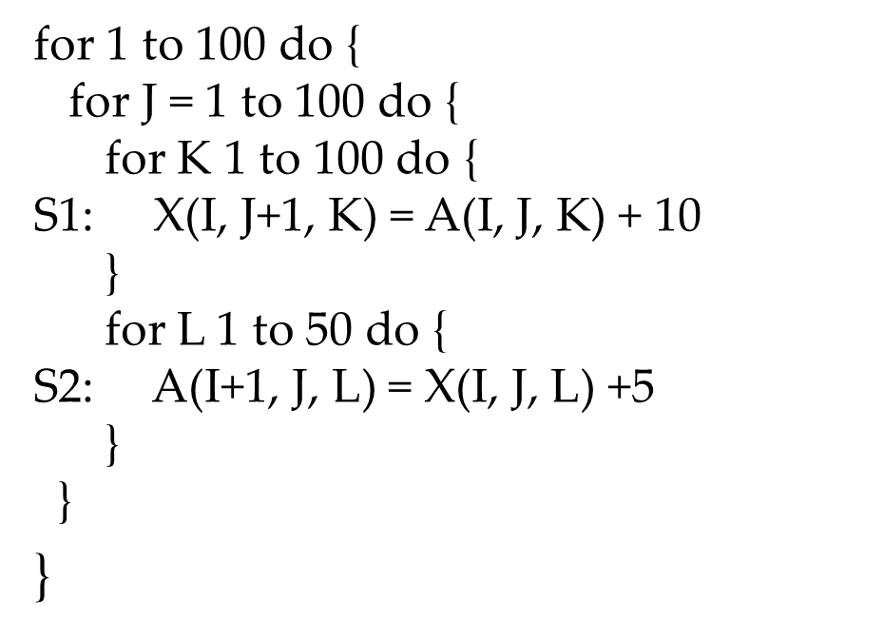
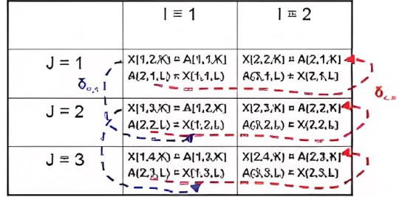
Cont..

Slide 20
Instruction Scheduling

Slide 21
Sensitivity to Instruction Order
Order of instruction execution has a significant effect on program performance
Different operations have different latencies
Same operation may have different latencies
Instruction scheduling is the task of ordering the operations to make effective use of processor resources
Input to the instruction scheduler is an unordered or partially ordered list of operations in say the target machine’s assembly language
Output is an order on the list of operations

Slide 22
Overlapping Instructions
Processors overlap instruction execution to make use of a finite set of functional units
Processor stalls an instruction until its operands are available
Scheduler can reorder instructions to minimize the number of stalls
Processor can also continue executing the instruction with wrong operands
Will need support for re-execution when correct operands are available
Need to maintain sufficient distance between the definition and the uses of the operand

Slide 23
Instruction Scheduling
A processor that relies on the compiler to insert NOPs for correctness is called a statically scheduled processor
Scheduler checks the availability of functional units
A processor that uses interlocks to ensure correctness is a dynamically scheduled processor
An interlock is a hardware mechanism to detect premature issue and introduces a delay
Scheduler checks availability of operands

Slide 24
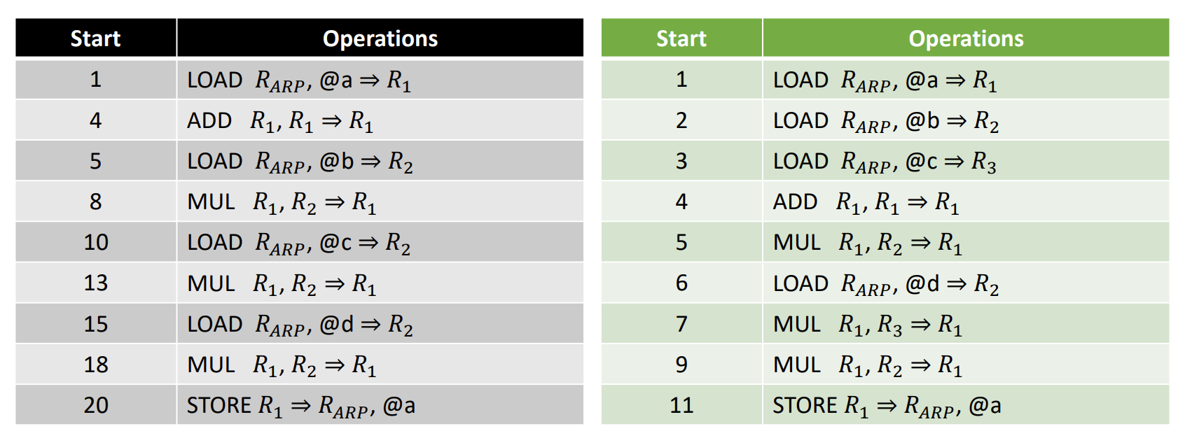
Instruction Scheduling Example
The column labelled “Start” shows the cycle in which each operation begins execution
Assume that the processor has a single functional unit, loads and stores take three cycles, a multiply takes two cycles, and all other operations complete in a single cycle.
With these assumptions, the original code, shown on the left, takes 22 cycles.

Slide 25
Instruction Scheduling Example
The scheduled code, executes in many fewer cycles.
It separates long-latency operations from operations that reference their results.
This separation allows operations that do not depend on these results to execute concurrently with the long-latency operations.
The code issues load operations in the first three cycles; the results are available in cycles 4, 5, and 6, respectively.
This schedule requires an extra register, r3, to hold the result of the third concurrently executing load operation, but it allows the processor to perform useful work while waiting for the first arithmetic operand to arrive.
The overlap among operations effectively hides the latency of the memory operations.
The same idea, applied throughout the block, hides the latency of the mult operation.
The reordering reduces the running time to 13 cycles, a 41 percent improvement.

Slide 26
Dependence Graph construction
Given a basic block 𝐵, its dependence graph is 𝐷 = (𝑁, 𝐸)
𝐷 has a node for each operation in 𝐵
An edge in 𝐷 connects two nodes 𝑛1 and 𝑛2 if 𝑛2 uses the result of 𝑛1
Edges represent flow of values
𝐷 is also called a precedence graph
Each node 𝑛 has two attributes
Operation type – functional unit on which the operation must execute
Delay – number of cycles to complete

Slide 27
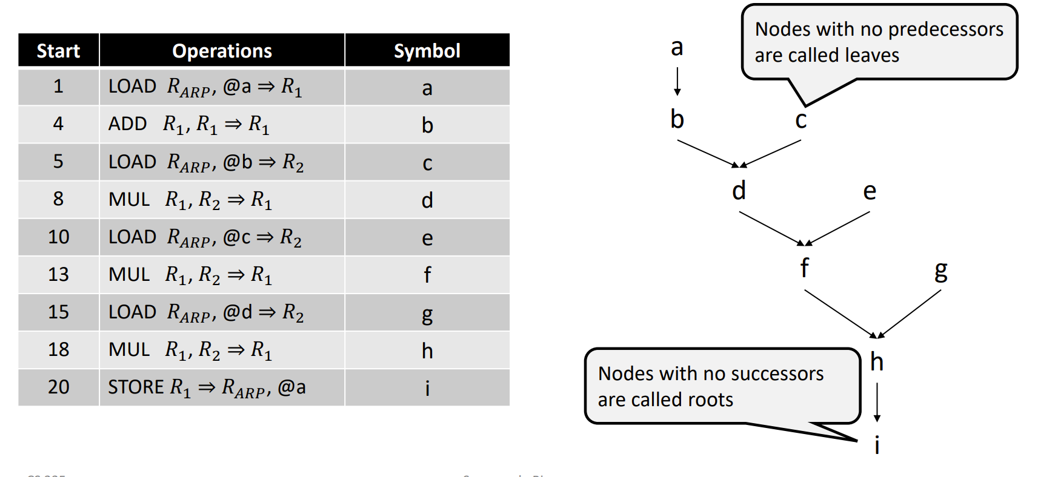
Example of a Dependence Graph

Slide 28
Instruction Scheduling
A schedule 𝑆 maps each node 𝑛 ∈ 𝑁 to a nonnegative integer that denotes the cycle in which it should be issued
An instruction 𝑖 can have multiple operations
Operations are denoted by {𝑛 | 𝑆 (𝑛) == 𝑖 }
Constraints
𝑆(𝑛) ≥ 1, with at least one operation 𝑛’ such that 𝑆(𝑛’) = 1
If (𝑛1, 𝑛2) ∈ 𝐸, then 𝑆(𝑛1) + 𝑑𝑒𝑙𝑎𝑦(𝑛1) ≤ 𝑆(𝑛2)
Each instruction contains no more operations of each type than the target machine can issue in a cycle

Slide 29
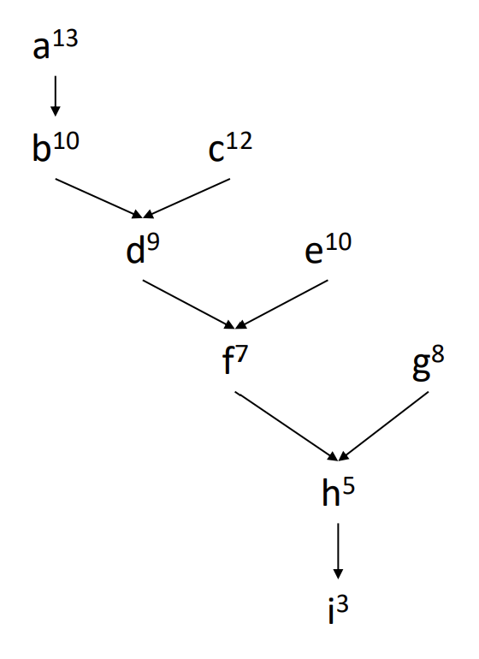
Cont…
Given a well-formed schedule, the length of the schedule is the cycle number in which the last operation completes
Assuming first instruction is issued at cycle 1, schedule length is
𝐿(𝑆) = max (𝑆(𝑛) + 𝑑𝑒𝑙𝑎𝑦(𝑛) )
A schedule 𝑆𝑖 is time optimal if 𝐿(𝑆𝑖) ≤ 𝐿(𝑆𝑗) ∀ 𝑆𝑗 ≠ 𝑆𝑖
Critical path is the longest latency path through D that determines overall execution time
Dependency Graph
𝑛∈𝑁

Slide 30
Cont…
Dependency Graph
‘a’ is on the critical path, so we should schedule ‘a’ first
‘c’ can be the next, since it now lies on the longest path
Better to schedule ‘e’ before ‘b’
Possible schedule = acebdgfhi

Slide 31
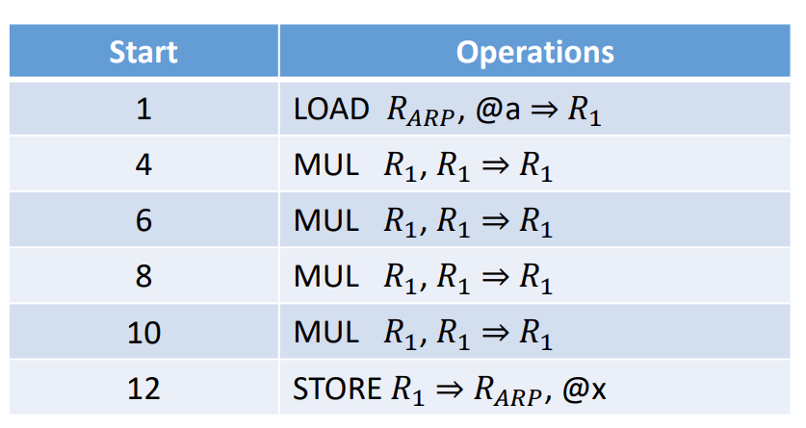
Limitations in Scheduling
Adjacent code has dependences that cannot be avoid during scheduling
Earlier passes may refactor the code to expose parallelism
(𝑎²)²× (𝑎²)²
Can proceed in parallel if there are more than one multiplication unit

Slide 32
Challenges in Scheduling
Scheduler needs to find a mapping between one or more operations and the clock cycle when they can start
A choice influences all reachable nodes
Instruction scheduling is NP-complete

Slide 33
List Scheduling
Greedy, heuristic based approach to schedule operations in a basic block
Steps in applying list scheduling
Rename values to avoid anti-dependences
Build a dependence graph 𝐷
Assign priorities to each operation
Iteratively select an operation for scheduling

Slide 34
Steps in List Scheduling
Rename values to avoid anti-dependences (optional step)
Each definition receives a unique name
Allows the scheduler more flexibility in identifying schedules
Build a dependence graph 𝐷
Scheduler traverses the block from bottom to top
Each node represents a new value
Each edge is annotated with the latency of the current operation

Slide 35
Steps in List Scheduling – cont…
Assign priorities to each operation
Scheduler computes several different scores for each node
Length of the longest latency weighted path from the node to a root in 𝐷
Priorities are used for ordering and breaking ties
Iteratively select an operation for scheduling
Start in the first cycle for the basic block
At each cycle, choose as many operations as possible to issue

Slide 36
Approach
Priority List based scheduling
Idea → Keep track of the ready List
Ready list
list of instruction that are ready to execute and takes any instruction from list
minimizes the no. of cycles.
Critical Path distance!
Length of the longest path from x to leaf Instruction
Any given point in time, track all that operation that are ready to execute and decide which of them are going to execute

Slide 37
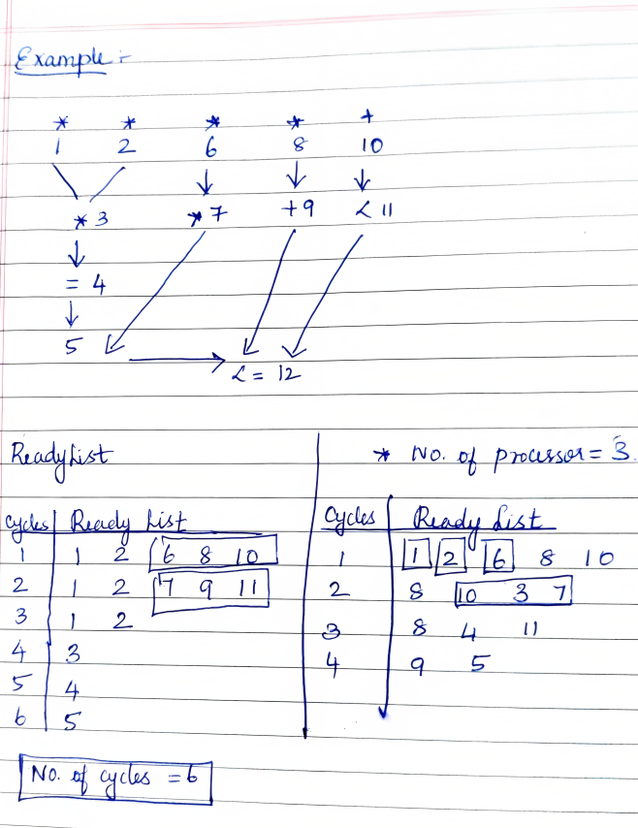
Example

Slide 38
Cont…

Slide 39
Software pipelining

Slide 40
Introduction to Software Pipelining
Overlaps execution of instructions from multiple iterations of a loop.
Executes instruction from different iterations in the same pipeline, so that pipelines are kept busy without stalls.
Initiation of a subsequent iteration may start even before the previous iteration is complete.
Unrolling loops several times and performing global scheduling on the unrolled loop

Slide 41
Unrolling loops
Loop unrolling is a loop transformation technique that helps to optimize the execution time of a program.
Remove or reduce iterations.
Loop unrolling increases the program’s speed by eliminating loop control instruction and loop test instructions.
Reduce the frequency of branches and loop maintenance instructions.

Slide 42
Unrolling loops
#include <stdio.h>
void main() {
int i = 1;
int a[100], b[100];
while(i<100) {
a[i] = b[i];
i++;
}
}
#include <stdio.h>
void main() {
int i = 1;
int a[100], b[100];
while(i<100) {
a[i] = b[i];
i++;
a[i] = b[i];
i++;
}

Slide 43
Three Stages
Prolog (Warm Up)
Stage contains instructions needed to build up the loop kernel cycle.
Loop Kernel (Cycle)
Within this loop , all instructions are executed in parallel.
Entire loop is executed in one cycle.
Epilog (cool off) -This stage contains the instructions necessary to complete all iterations

Slide 44
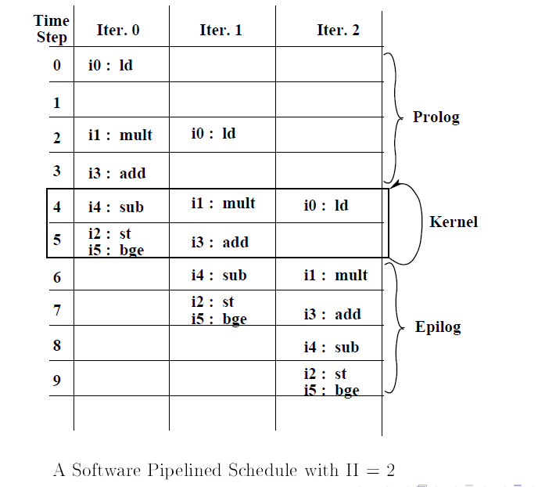

Slide 45
Approaches to Software Pipelining
Involves finding initiation interval for successive iterations.
Trial and error procedure
Start with minimum II, schedule the body of the loop using one of the approaches below and check if schedule length is within bounds
Stop, if yes
Try next value of II, if no
Iterative modulo scheduling
Uses Modulo Reservation Tables(MRT)
Notes:
the number of clock cycles between the launch of successive loop iterations.

Slide 46
Modulo Reservation Tables (MRT)
Modulo Reservation Tables (MRT)
A global resource reservation table with II columns and R rows
II columns- Initiation Interval (new iteration)
R Rows- number of resources in the system
Schedule lengths are dependent on II, dependence
Distance between instructions and resource contentions

Slide 47
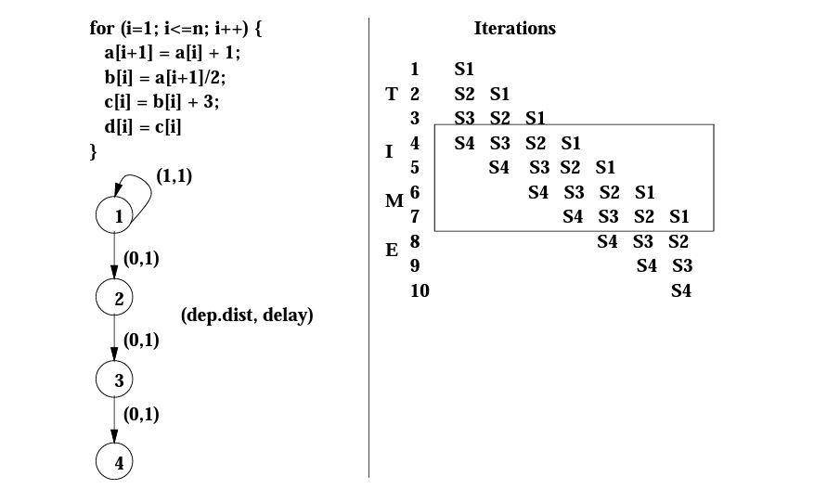
Example 1

Slide 48
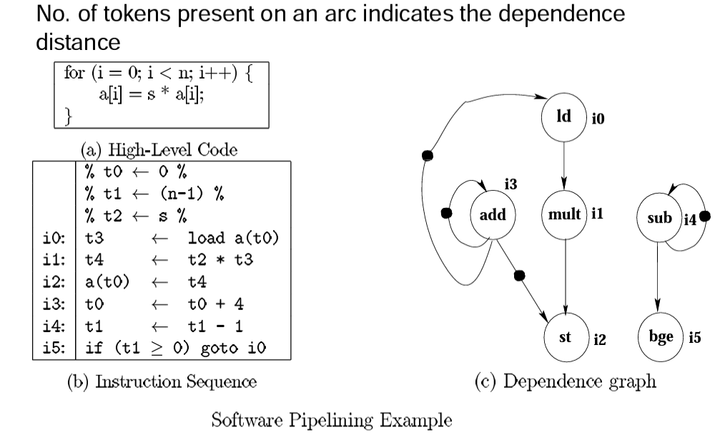
Example 2

Slide 49
Example 2
Number of tokens present on an arc indicates the dependence distance
Assume that the possible dependence from i2 to i0 can be disambiguated
Assume 2 INT units (latency 1 cycle), 2 FP units (latency 2 cycles), and 1 LD/STR unit (latency 2 cycles/1 cycle)
Branch can be executed by INT units
Acyclic schedule takes 5 cycles
Corresponds to an initiation rate of 1/5 iteration per cycle
Cyclic schedule takes 2 cycles

Slide 50
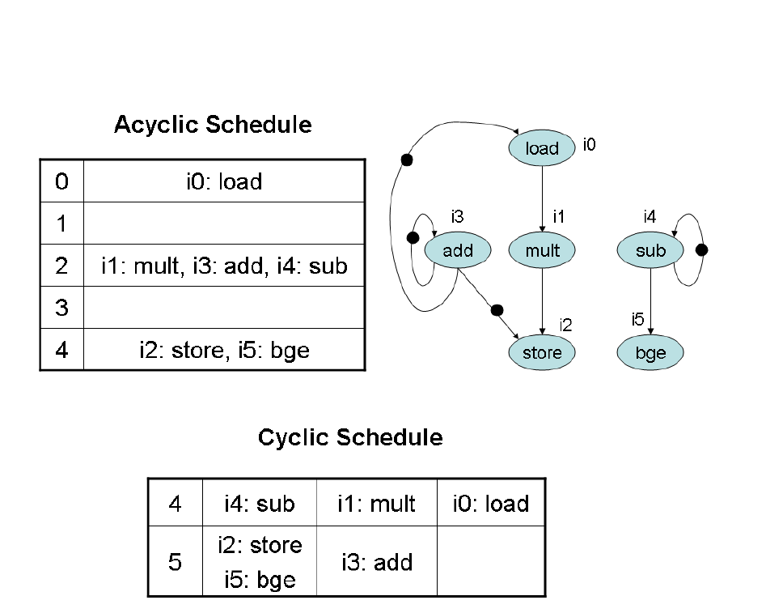

Slide 51
Module Wise Mark Split-up for FAT
Module 1 :Marks
Module 2: Marks
Module 3: Marks
Module 4: Marks
Module 5: Marks
Module 6: Marks
Module 7: Marks

